Slide 1
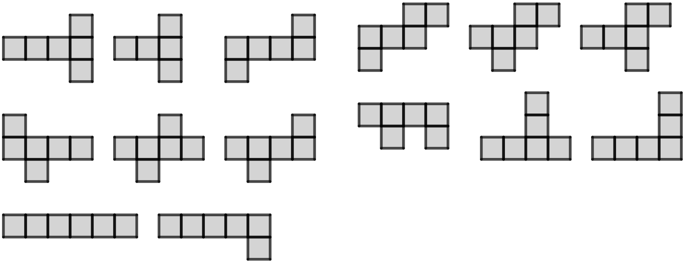
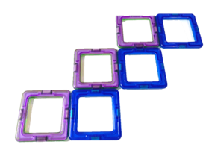
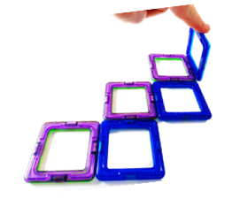
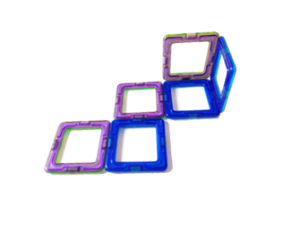
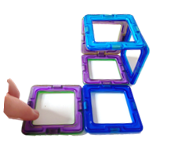
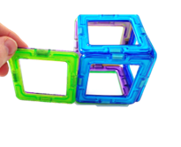
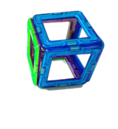
Surface area of cuboids
Task A: Nets of cuboids
1) Groups are either: all nets that can fold up into cubes, or all composite shapes that won’t fold up into cubes.
a) Can you spot any patterns or similarities with each of the shapes in a group?
There are many possible observations, for example:
All the shapes in group A have a horizontal line of four squares, with one square above and below it that move around.
Group C have 5 or 6 squares in a row, which is more than any other group.
b) Which groups can fold up into cubes, and which can’t?
Groups A, B, and D all fold into cubes.
C and E do not.
A
1
A
2
A
3
B
1
B
2
B
3
C
1
C
2
D
1
D
2
D
3
E
1
E
2
E
3
c) Can you come up with any potential rules for arrangements of 6 squares that definitely are or definitely are not nets of cubes?
No arrangement with 5 or more squares in a row or column can make a cube.
Squares distributed into only two rows or columns cannot make a cube, but it is possible for three rows.
d) There is one unique net (not a rotation or reflection of one in a group) that isn’t given. Can you draw this missing net and fold it up into a cube to check?

Slide 2
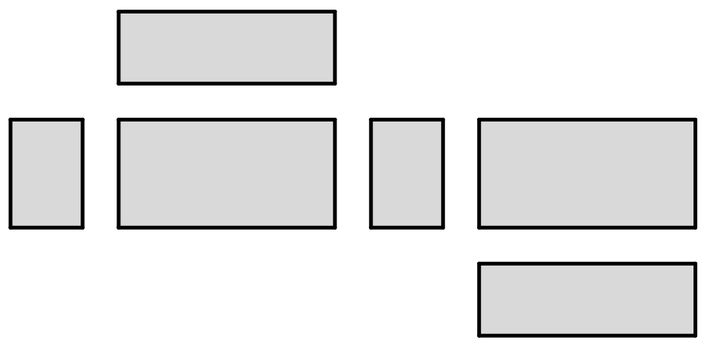

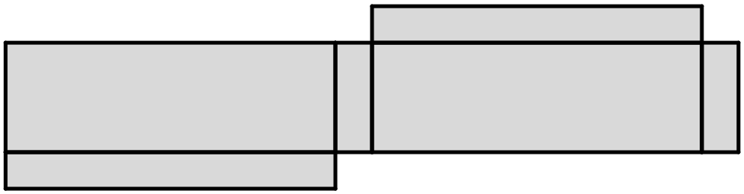
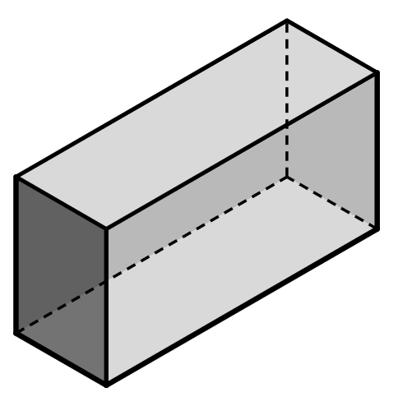
Surface area of cuboids
Task B: Surface area of cuboids from nets
1) These six rectangles can be connected to create the net of a cuboid.
6 units
c
84
a) Calculate the area of the three rectangles labelled a, b, c.
a
b
10 units
60
140
60
140
b) The three remaining rectangles have the same areas as in part a. Write the correct area on the corresponding rectangle.
6 units
14 units
84
c) Hence, find the surface area of the cuboid.
568 units²
2) By finding the area of at least three rectangles, complete the calculation to find the surface area of the cuboid which would be made from this net.
15 cm
8 cm
8 cm
25 cm
the surface area of this cuboid is:
120
200
1390
375
2( + + ) = cm²
Task C: Surface area of cuboids from 3D representations
1) Complete the calculations to find the surface area of this cuboid.
5
10
front = 2 × =
10
back =
11
5
right = × =
5 cm
55
55
left =
22
11 cm
bottom = 2 × 11 =
22
2 cm
top =
174 cm²
surface area =
v2.3

Slide 3
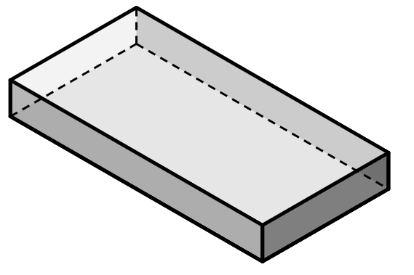
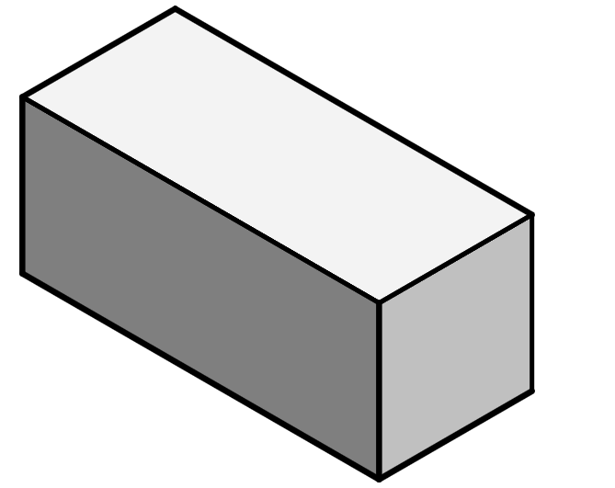
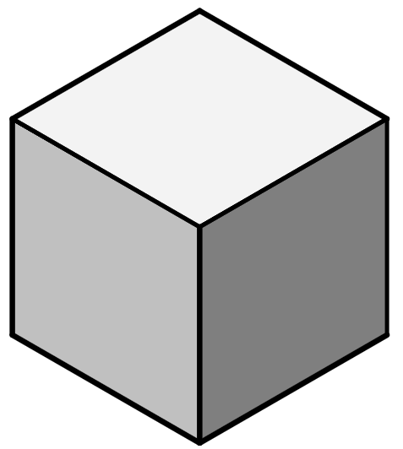
Surface area of cuboids
Task C: Surface area of cuboids from 3D representations
2) Complete the calculations to find the surface area of this cuboid.
front and back
30 × 4 × 2 =
240
left and right
× × 2 =
12
4
96
30 m
4 m
top and bottom
30 × × =
12 m
12
2
720
240
96
720
1056 m²
surface area = + + =
3) Complete the calculations to find the surface area of this cuboid.
112
front = .
right = .
top = .
56
7 inches
128
112
56
128
592 inches²
16 inches
8 inches
surface area = 2 ( + + ) = .
4) This is a cube.
a) Calculate the area of the front, right, and top faces of the cube, and hence calculate the surface area.
front =
right =
top =
surface area = 2( + + ) =
25
25
5 m
25
25
25
25
150 m²
b) Jun says there is a quicker way of calculating the surface area of a cube. Is Jun correct? If so, show a more efficient calculation to find the surface area of a cube.
6 × 5² = 150
Mathematics in Education and Industry.

